Slide 1
Bitcoin Market Analysis
Team: Error 404 - Group Not Found Course: IS665 Date: 2nd April 2019

Slide 2
Data Source: Kaggle Important columns: Bitcoin market price Date Market capital hash rate difficulty Total bitcoins Variable to predict: bitcoin market price Approach: time series forecasting
DATASET:

Slide 3
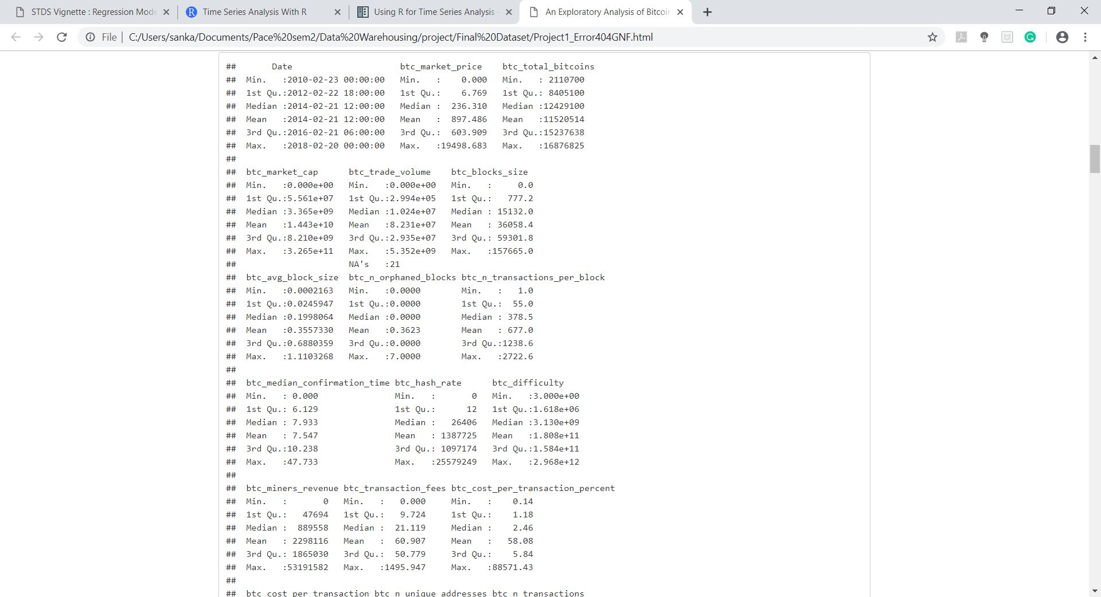
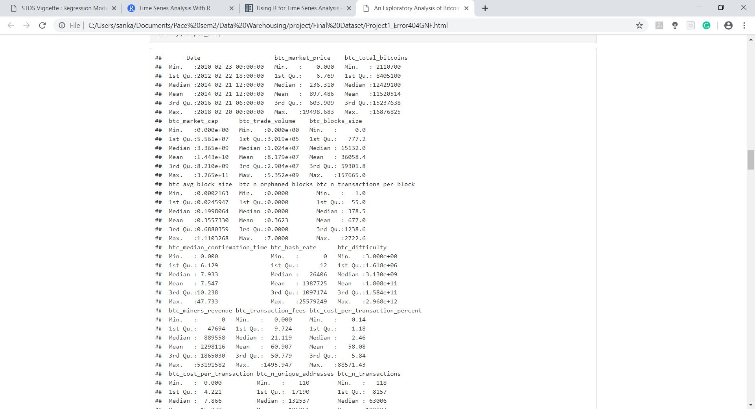
Data cleaning:
NEED OF DATA CLEANING?
WHY DATA CLEANING WAS REQUIRED IN OUR DATASET
OUR APPROACH FOR DATA CLEANING

Slide 4
Exploratory data analysis:
CORELATION OF BITCOIN MARKET PRICE WITH OTHER IMPORTANT VARIABLES

Slide 5
PREDICTIVE DATA ANALYSIS : ARIMA MODEL Introduction to arima:
WHAT IS TIME SERIES?
AUTO REGRESSION
MOVING AVERAGE
LAG VALUES
WHAT IS ARIMA MODEL?

Slide 6
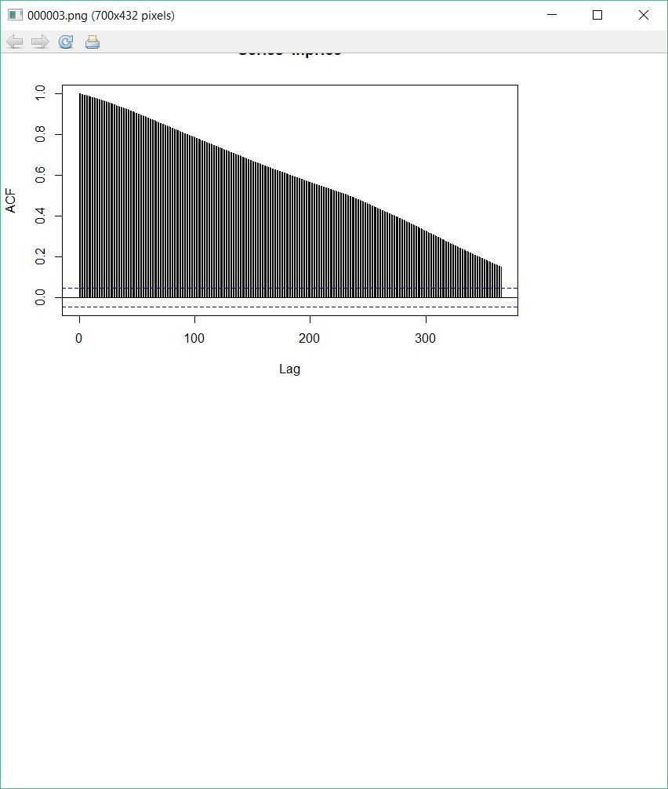
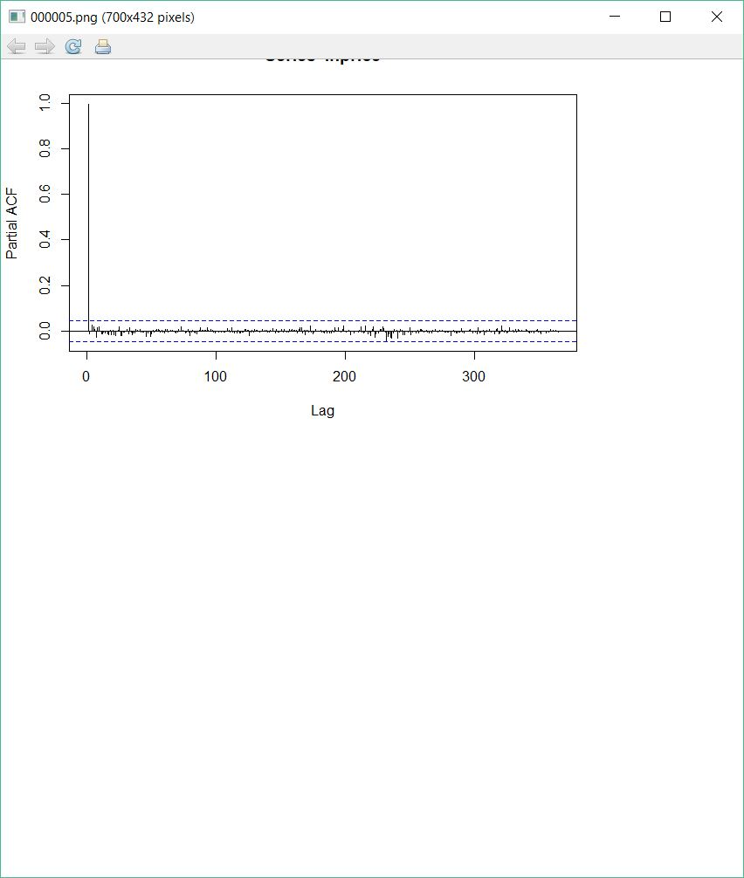
REQUIREMENTS FOR ARIMA:
ACF PLOT PACF PLOT

Slide 7
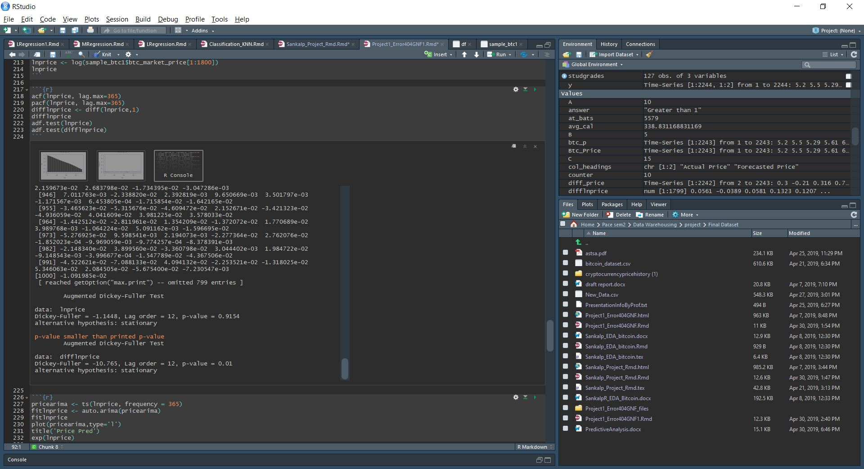
AUGMENTED DICKEY-FULLER TEST

Slide 8
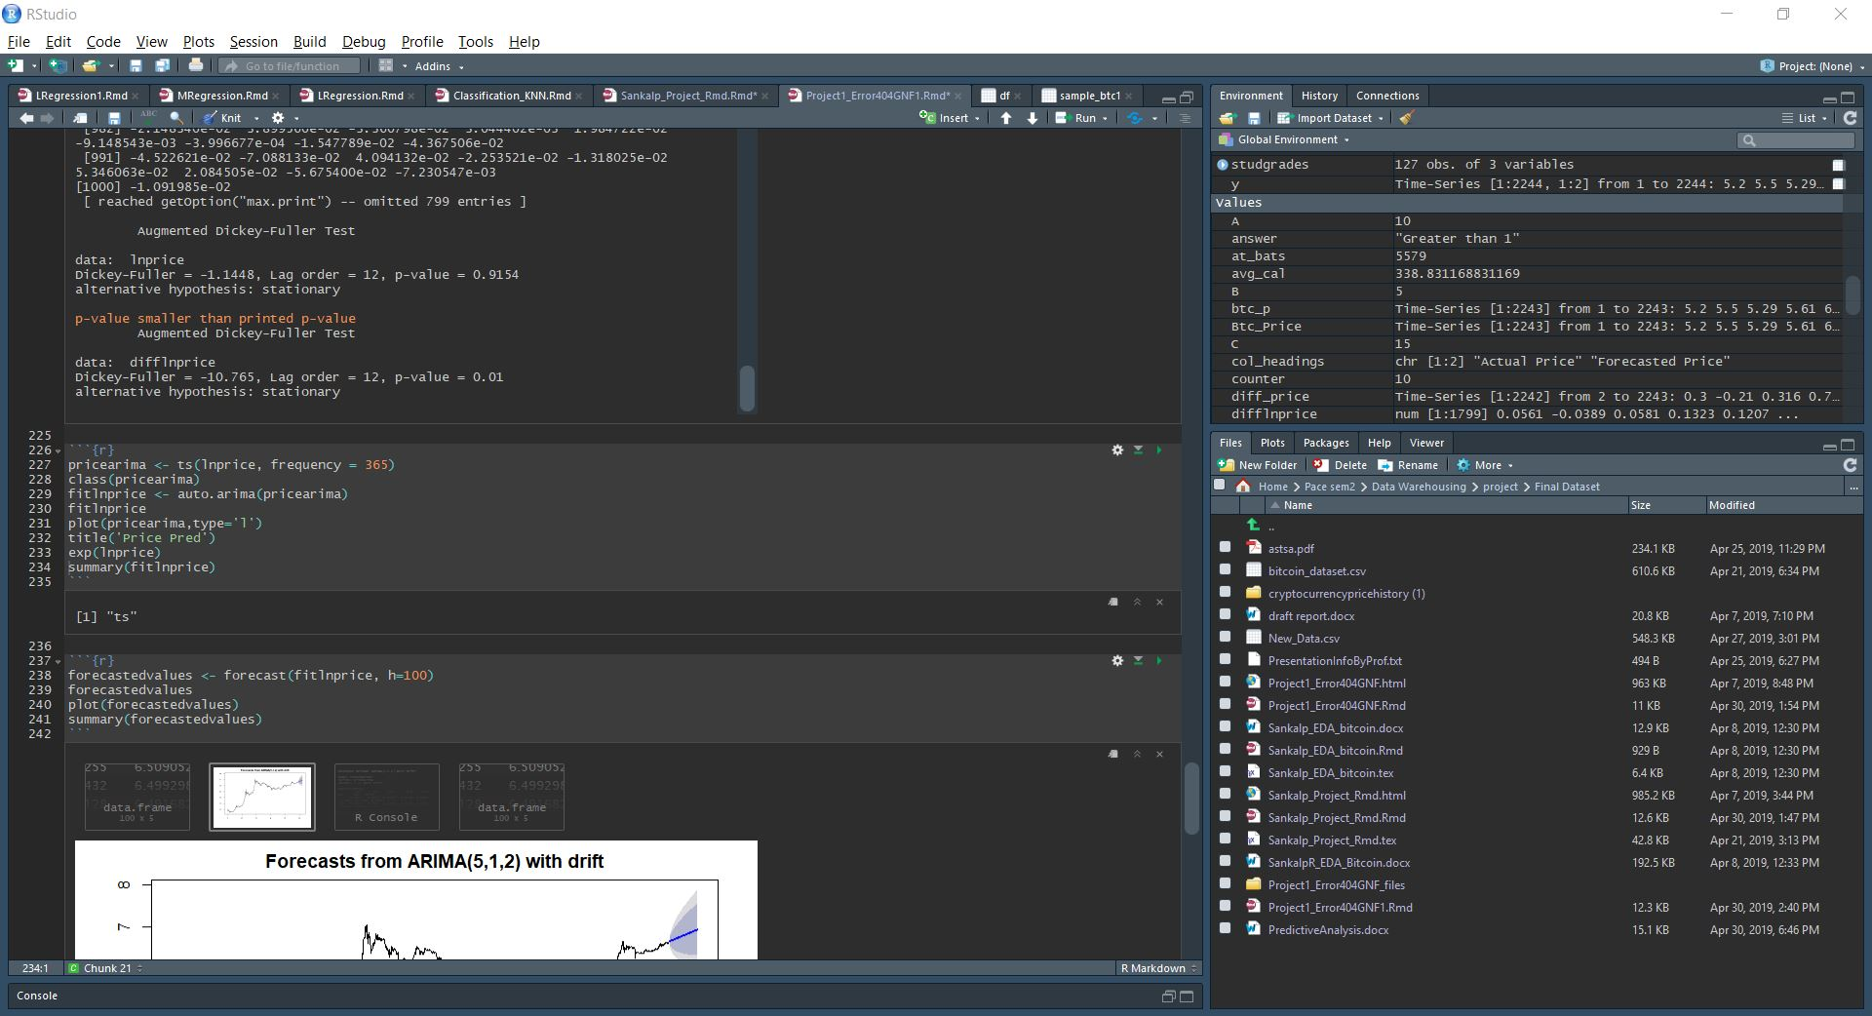
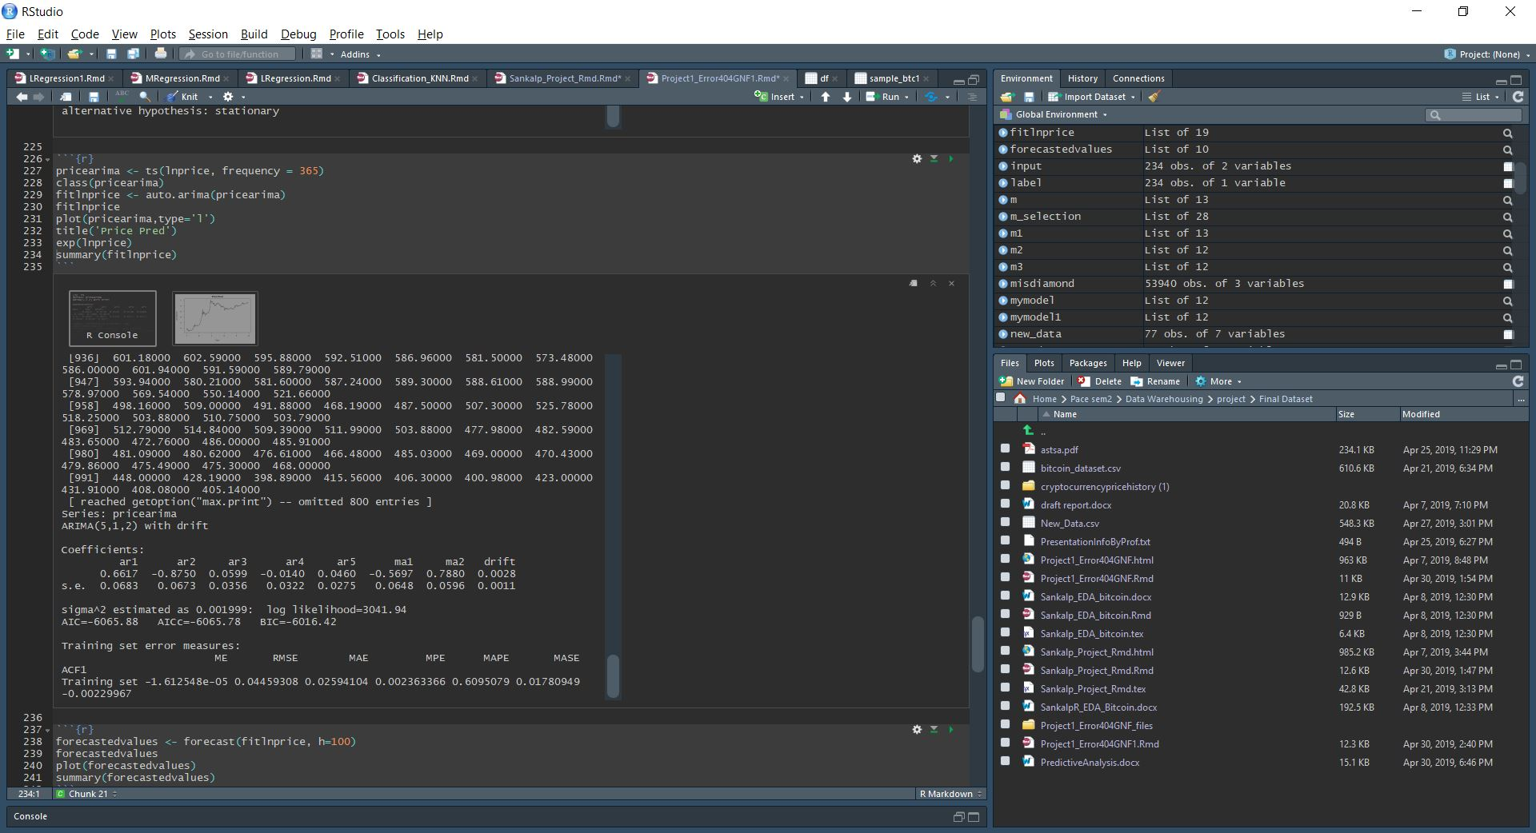
MODEL AND SUMMARY:

Slide 9
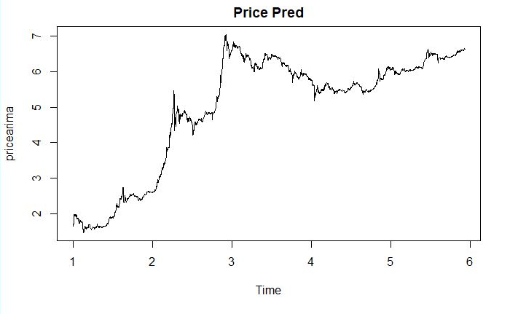
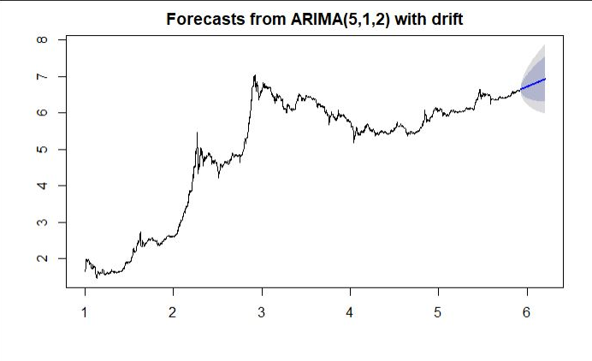
Initial and FORECASTed PRICE:
INITIAL TREND FORECASTED TREND

Slide 10
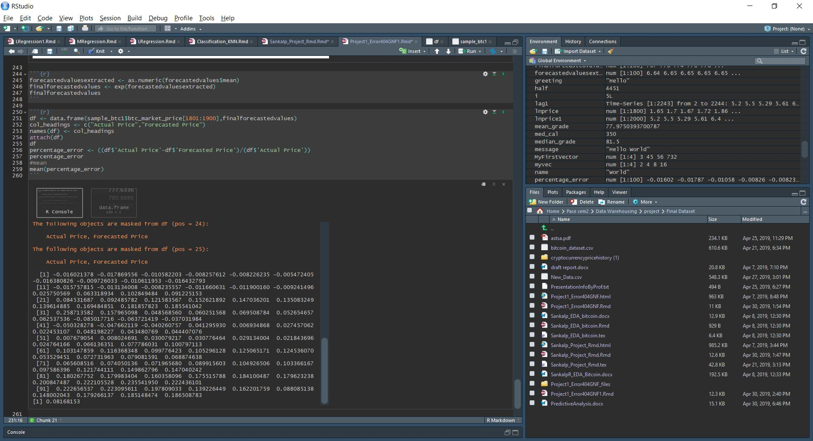
ERROR PERCENTAGE:
MEAN ERROR PERCENTAGE: 8.16%

Slide 11
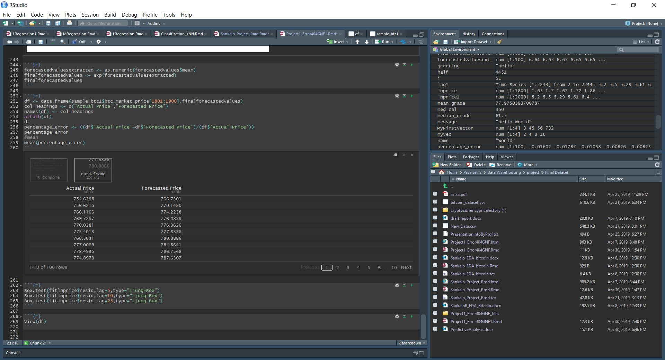
OUTPUT OF OUR MODEL:

Slide 12
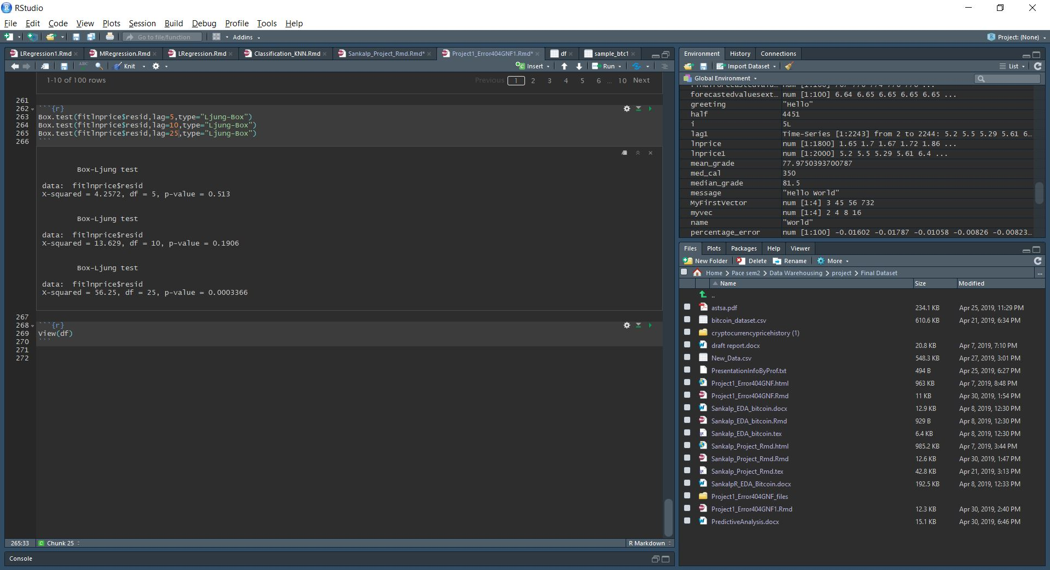
TESTING OUR MODEL:
BOX TEST

Slide 13
THANK YOU!

